Slide 1

Programming
Pass by Reference

Slide 2

Passing Parameters by Reference
To have a function with multiple outputs, we have to use pass by reference.
Reference (address) of parameter is passed to the function, instead of its value.
If the function changes the parameter value, the changes will be reflected in the program calling it.
How to pass parameters by reference:
  <type>& <variable>, ... , <type>& <variable>

Slide 3

Pass by Reference: Example 1
To show how the function affects a variable which is used as a parameter:
#include <iostream>
using namespace std;
void Increment(int& Number){
Number = Number + 1;
cout << "The parameter Number: " << Number << endl;
}
void main(){
int I = 10;
Increment(I); // parameter is a variable
cout << "The variable I is: " << I << endl;
}

Slide 4

Pass by Reference: Example 2
It is possible to use both pass by reference and pass by value parameters in the same function.
// Print the sum and average of two numbers
// Input: two numbers x & y
// Output: sum - the sum of x & y
// average - the average of x & y
#include <iostream>
using namespace std;
void SumAve (double, double, double&, double&);

Slide 5

Pass by Reference: Example 2
void main ( ) {
double x, y, sum, mean;
cout << "Enter two numbers: ";
cin >> x >> y;
SumAve (x, y, sum, mean);
cout << "The sum is " << sum << endl;
cout << "The average is " << mean << endl;
} void SumAve(double no1, double no2, double& sum, double& average) {
sum = no1 + no2;
average = sum / 2;
}

Slide 6
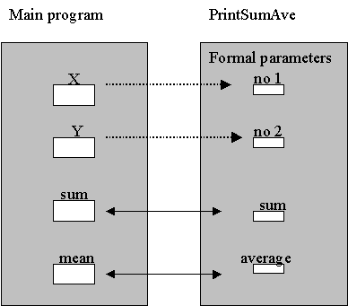

Pass by Reference: Example 2
Data areas after call to SumAve:

Slide 7

Pass by Reference: Example 3
// Compare and sort three integers
#include <iostream>
using namespace std;
void swap (int&, int&);
void main ( ) {
int first, second, third; // input integers
// Read in first, second and third.
cout << "Enter three integers: ";
cin >> first >> second >> third;
if (first > second) swap (first, second);
if (second > third) swap (second, third);
if (first > second) swap (first, second);
cout << "The sorted integers are " << first << " , " << second << " , " << third << endl;
}

Slide 8

Pass by Reference: Example 3
// Function for swapping two integers
void swap (int& x, int& y) {
int temp;
temp = x;
x = y;
y = temp;
}

Slide 9

Pass by Reference: Example 4
// Pass-by-reference verses pass-by-value example
#include <iostream>
using namespace std;
void One (int a, int b, int& c) {
int d;
a = 10; b = 11; c = 12; d = 13;
cout << "The values of a, b, c, and d in One: ";
cout << a << " " << b << " " << c << " " << d << endl;
}
void Two (int a, int b, int& d) {
int c = 0;
cout << "The values of a, b, c, and d in Two: ";
cout << a << " " << b << " " << c << " " << d << endl;
}

Slide 10

Pass by Reference: Example 4
void main () {
int a = 1, b = 2, c = 3, d = 4;
One(a, b, c);
cout << "The values of a, b, c, and d after One: ";
cout << a << " " << b << " " << c << " " << d << endl;
Two(a, b, d);
cout << "The values of a, b, c, and d after Two: ";
cout << a << " " << b << " " << c << " " << d << endl;
}

Slide 11

Programming
Passing Arrays to Functions

Slide 12

Array Element Pass by Value
Individual array elements can be passed by value or by reference
Pass-by-value example:
void printcard(int c) {
if(c==1)
cout << "A";
...
}
void main() {
int cards[5] ;
...
for(int n=0; n<5; n++)
printcard(card[n]);
}

Slide 13

Array Element Pass by Reference
Pass-by-reference example:
void swap(int& x, int& y) {
int temp;
if (x > y){
temp = x;
x = y;
y = temp;
}
}
void main() {
int A[10] = {9,8,7,6,5,4,3,2,1,0};
swap(A[3], A[5]);
}

Slide 14


Array Element Pass by Reference
Before:
After:

Slide 15

Passing
Entire Arrays to Functions
Arrays can be passed to functions in their entirety.
All that is required is the address of the first element and dimensions of the array.
The remainder of the array
will be passed by
reference
automatically.

Slide 16

Arrays to Functions: Example 1
//Find the largest value in an array
//input: n - number of elements to check
// a[ ] - array of elements
// output:index to the largest element
#include <iostream>
using namespace std;
int max_element(int n, const int a[]) {
int max_index = 0;
for (int i=1; i<n; i++)
if (a[i] > a[max_index])
max_index = i;
return max_index;
}
void main() {
int A[10] = {9,8,7,6,5,4,10,2,1,0};
cout << A[max_element(10,A)] << endl;
}

Slide 17

Arrays to Functions: Example 2
//Add a[i] and b[i] and store the sum in c[i]
//Array elements with subscripts ranging from
//0 to size-1 are added element by element
void add_array(int size, const double a[],
const double b[], double c[]){
for (int i=0; i<size; i++)
c[i] = a[i] + b[i];
}
In main():
add_array (5, x, y, z );

Slide 18
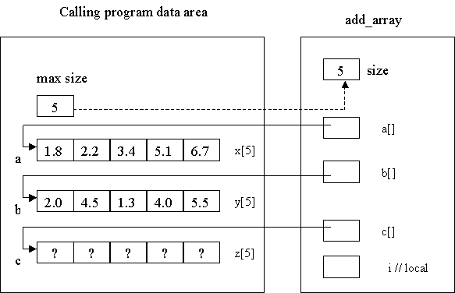
Arrays to
Functions: Example 2

Slide 19
Passing Multidimensional Arrays
How to pass a multidimensional array to a function:
void displayBoard(int b[][4]);
// function prototype requires variable name for arrays
void main(){
int board [4][4];
...
displayBoard(board);
...
}
void displayBoard(int b[][4]){
// could also be: void displayBoard(int b[4][4]){
// but NOT: void displayBoard(int b[][]){
...
}
When passing a multidimensional array, only the size of the 1st dimension is optional, the 2nd, 3rd, etc. dimensions must be specified.

Slide 20
Function Overloading

Slide 21
Function Overloading
Functions with same name but having different signatures are called overloaded functions.
Function Name + List of arguments is called signature.
Signature does not include the return type of a function.

Slide 22
Function Overloading
So the name will be same only distinguishing feature is list of arguments.
List of arguments can be made different on the basis of:
  Number of Arguments.
  Type of Arguments.

Slide 23
Example
int sum(int a, int b)
{ return a+b; }
int sum(int a, int b, int c)
{ return a+b+c }
float sum(float a, float b)
{ return a+b; }
void main(void)
{
cout<< sum(10, 20);
cout<<sum(10, 20, 30);
cout<<sum(7.5, 10.0);
}

Slide 24
Explanation
In the above example:
  int sum(int a, int b);
  Int sum(int a, int b, int c);
These functions are overloaded on the basis of number of arguments.
As one function has two arguments and second has three arguments in the argument list but the type is same

Slide 25
Explanation
In the above example:
  int sum(int a, int b);
  float sum(float a, float b);
These functions are overloaded on the basis of type of arguments.
As both of the functions contain two arguments but there type is different.

Slide 26
Thanks

